Slide 1

RURAL REACH
"Empowering rural livelihoods, connecting you closer"
GROUP 1
ASLAH 15
FAZEEL ANWAR 24
MOHAMMED ROSHAN P 43
ROHITH CM 60

Slide 2
AGENDA
01
02
03
INTRODUCTION
PROBLEM STATEMENT
RESEARCH GAPS
04
05
06
FUNCTIONALITIES
STAKE HOLDERS
REQUIREMENT COLLECTION METHODS

Slide 3
AGENDA
SOFTWARE REQUIREMENTS
08
09
07
IMPLEMENTATION DETAILS
INTERMEDIATE
RESULT

Slide 4
INTRODUCTION
In today's world, where people are becoming more and more health-conscious, the demand for organic products is on the rise.
Unfortunately, many small-scale farmers and producers face challenges in getting their products to market.
Our application seeks to address this issue by providing a user-friendly platform for them to showcase their products to a wider audience.

Slide 5
PROBLEM STATEMENT
1)Conventional farming Practices and Food Supply chain include
multiple intermediaries
Limited access to fresh and healthy organic produce.
Raise in the price of produce.
Farmers face challenges to find market.
Loss of revenue for farmers.
2)Difficulties in transportation and distribution
3)Lack of publicity is one of the significant issues
faced by small scale household industries in India

Slide 6
RESEARCH GAPS
Limitations in the existing scenario
Organic farmers have to compete openly with inorganic large scale farmers.
The presence of intermediaries and middlemen often results in significant profit leakage within the supply chain.
No exclusive platform for organic farmers and household industries

Slide 7
STAKEHOLDERS
FARMERS
CUSTOMERS
DELIVERY PERSONNEL
INVESTORS
COMPETITORS
SUPPLIERS

Slide 8
REQUIREMENT COLLECTION METHODS
ONE ON ONE INTERVIEW
BRAINSTORMING
DOCUMENT ANALYSIS
SURVEY
Conducted a one-on one interview
Gathered Brainstorming ideas
Referred 5-7 research papers
Conducted survey from Farmers

Slide 9
LITERATURE REVIEW
Sr.No | Author | Name of the paper | Description
1 | National Bank for Agriculture and Rural Development | Organic farming in India Relevance,Problems and Constraints | Lack of marketing and distribution networks for organic inputs, and retailers are not interested due to low demand
2 | Indian Express | Organic farmers seek help as Horticorp lets them down. | The article reports on the struggles faced by organic farmers in Kerala, India, due to the lack of support from Horticulture Corporation.
3 | Seemant Yadav and Dr vikas Tripati | CHALLENGES AND OBSTACLES FACED BY MICRO, SMALL AND MEDIUM SIZED ENTREPRISES (MSMES) IN INDIA | 1. Limited transportation network​ 2. Limited communication network​ 3. Low levels of infrastructure and technology​ 4. Involvement of middlemen

Slide 10
SURVEY REPORT
CHALLENGES FACED BY FARMERS
25%
50%
75%
Satisfied
Market access
Fair price
Only 25% percent of the people were satisfied with the existing norms.
50% of the people have limited market access.
Majority of the farmers do not get a fair price for their produce.

Slide 11
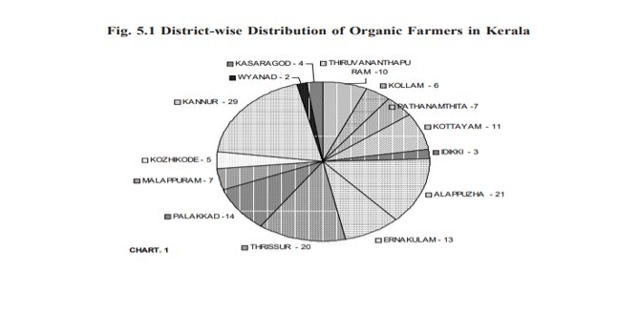
FUTURE IN THE PAST: A STUDY ON THE STATUS OF ORGANIC FARMING IN KERALA ​ -BY BALACHANDRAN V​

Slide 12
FUNCTIONALITIES
1.User can buy and sell product in a single
login
2.Signup and user authentication
3.Pickup station management
4.Payment gateway

Slide 13
SELLER FUNCTIONALITIES
1.Create or update profile
Create profile with their description or tags
2.Add product
Can specify items with price, image ,quantity
3.Manage products
Added products can be edited

Slide 14
BUYER FUNCTIONALITIES
1.Product catalog
View the available products along with image ,description,price, seller name etc
2.Search Functionality
Can search product with product name or seller name
3.Reviews and Ratings
Enable customers to post their reviews

Slide 15
BUYER FUNCTIONALITIES
4.CALL OR CHAT
User can call or chat with seller
5.Cart
Total orders that the buyer made are listed in this page.Order status are also updated in realtime.

Slide 16
SOFTWARE REQUIREMENTS
Flutter framework
Product API
Backend Framework [FIREBASE]
D7 verify API -OTP service provider

Slide 17
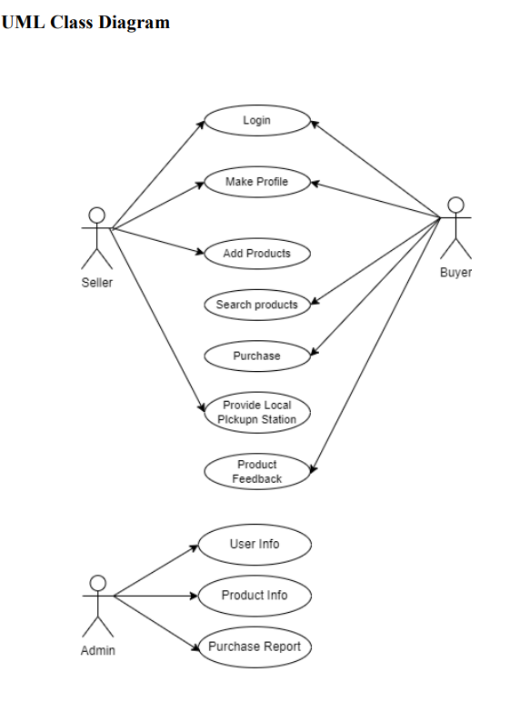
UML CLASS DIAGRAM

Slide 18
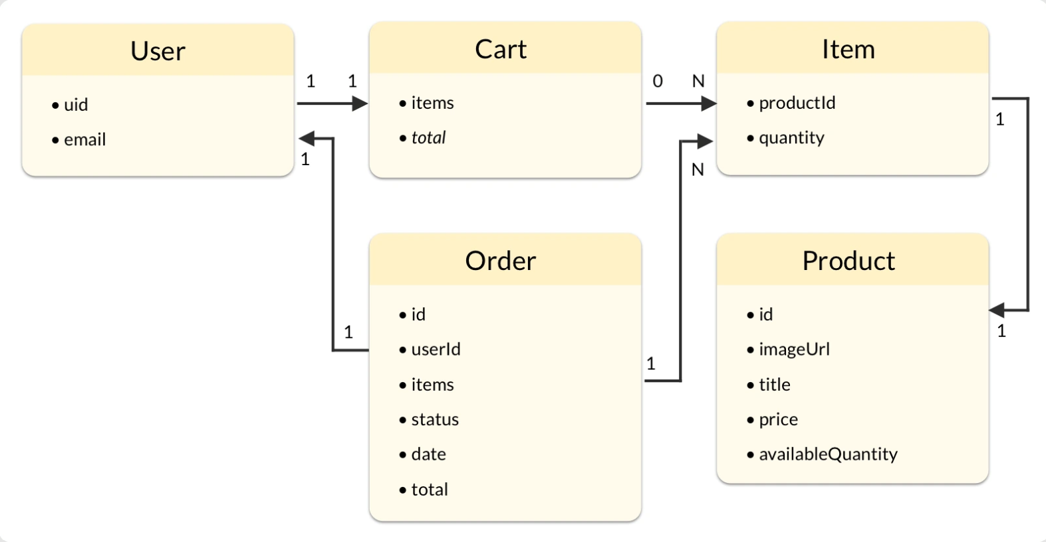
ENTITIES IN THE APP

Slide 19
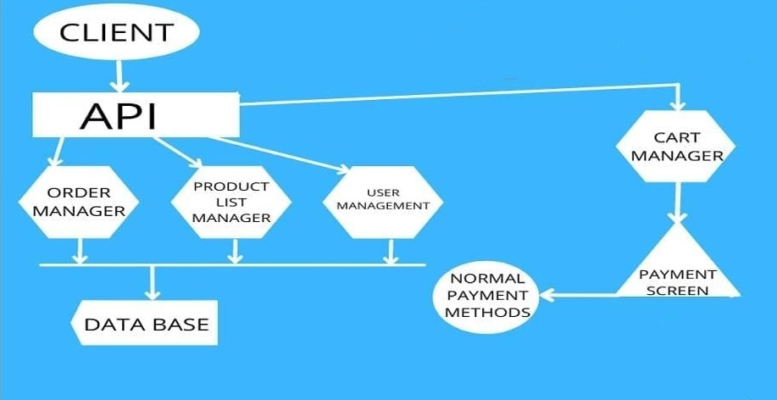
ARCHITECTURE DIAGRAM

Slide 20
Implementation Details:Timeline
01
02
Requirement collection and analysis
Learning and Designing
03
04
Development
Test and Deployment
Initial 1 week was spent for gathering informations,defining project objectives and developing a plan
Learning necessary skills and designing the UI/UX part for a user friendly app was our next task
Building the app based on our design,integrating backend API’s,implementing user authentication etc.
Do tests,fix bugs and deploy the app in a accessible platform is the next stage.

Slide 21
Phase 1:Requirement collection & analysis
Developed SRS document based on requirements
Conducted market study
Developed project plan
Developed software design specification

Slide 22
Phase 2:Learning and Designing
01
02
Designed app pages in figma
Learning Flutter and Dart basics
03
04
Learned firebase and noSQL database design
Review and iteratively changing design

Slide 23
Phase 3:Development
Apps Front end development using Flutter
Implementing basic database functionalities
Develop seamless animations
Develop User authentication

Slide 24
Phase 4:Test and Deployment
01
02
Unit testing
Integration testing
03
04
Deploy application
Beta testing and maintanence

Slide 25
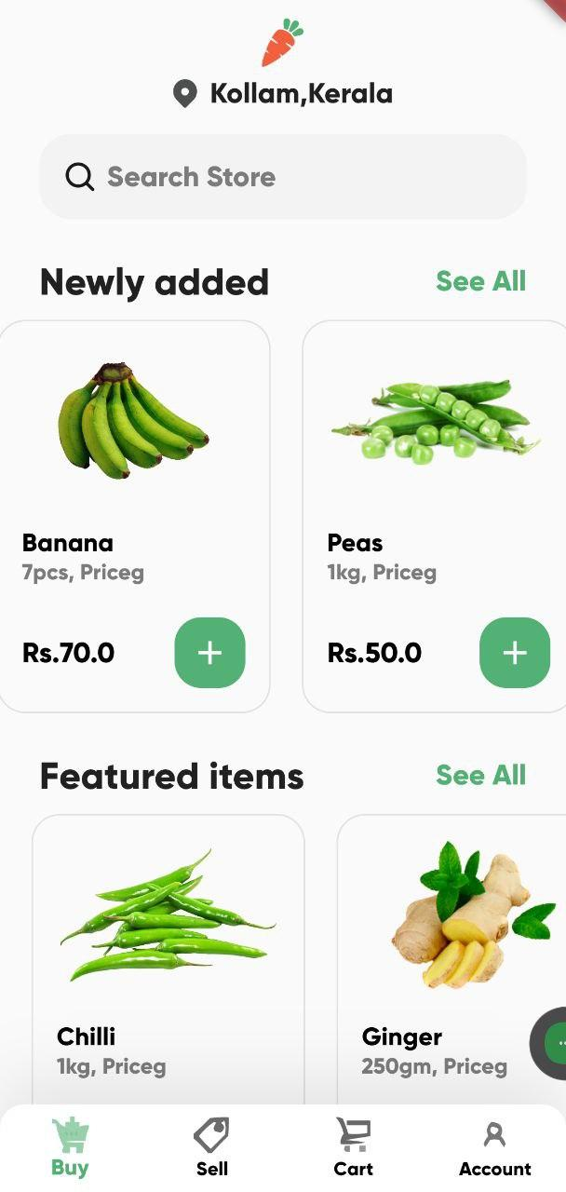
INTERMEDIATE RESULTS
1)Buy Screen

Slide 26
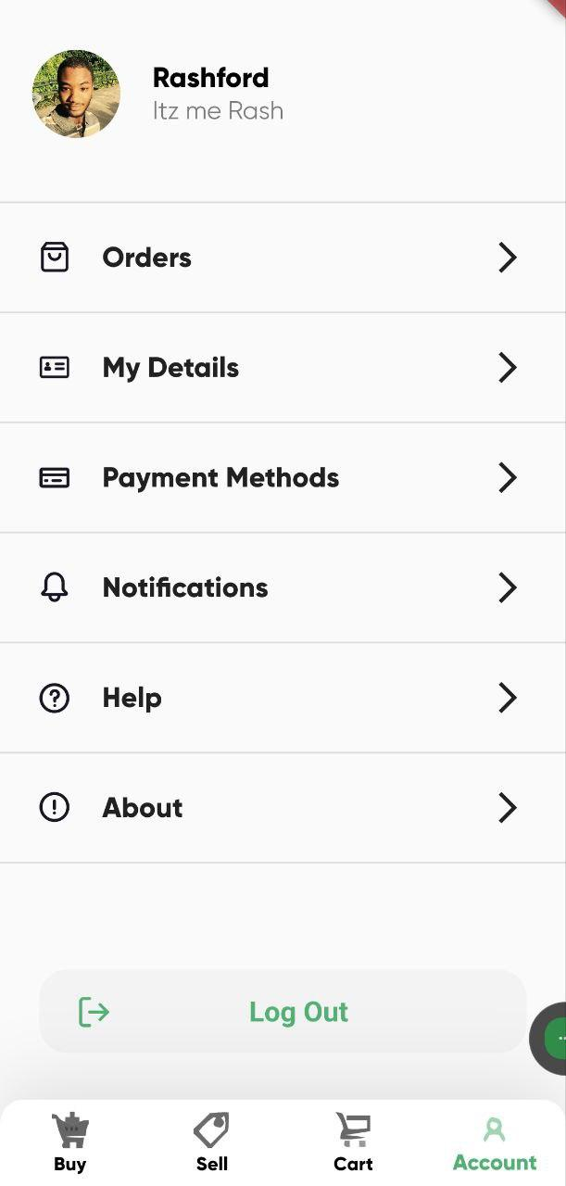
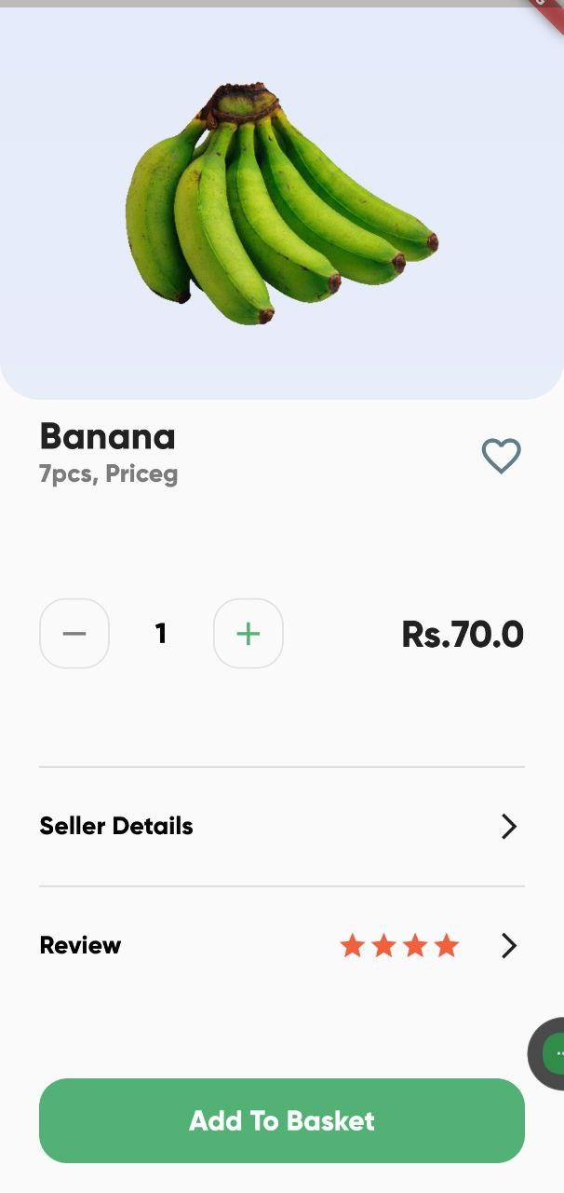
3)Account Screen
2)Product Details Screen

Slide 27
THANKS

